Slide 1
CHAPTER 7 Strategies for Competing in International Markets

Slide 2
LEARNING OBJECTIVES
THIS CHAPTER WILL HELP YOU UNDERSTAND:
The primary reasons companies choose to compete in international markets
How and why differing market conditions across countries influence a company’s strategy choices in international markets
The five major strategic options for entering foreign markets
The three main strategic approaches for competing internationally
How companies are able to use international operations to improve overall competitiveness
The unique characteristics of competing in developing-country markets

Slide 3


Why companies decide to enter foreign markets
WHY COMPANIES DECIDE TO ENTER FOREIGN MARKETS
To gain access to new customers and meet current customer needs
To gain access to lower-cost inputs of production
To further exploit core competencies
To achieve lower costs through economies of scale, experience, and increased purchasing power
To gain access to resources and capabilities located in foreign markets
Jump to Appendix 1 long image description

Slide 4
WHY COMPETING ACROSS NATIONAL BORDERS MAKES STRATEGY-MAKING MORE COMPLEX
1. | Different countries with different home-country advantages in different industries
2. | Location-based value chain advantages for certain countries
3. | Differences in government policies, tax rates, and economic conditions
4. | Currency exchange rate risks
5. | Differences in buyer tastes and preferences for products and services

Slide 5
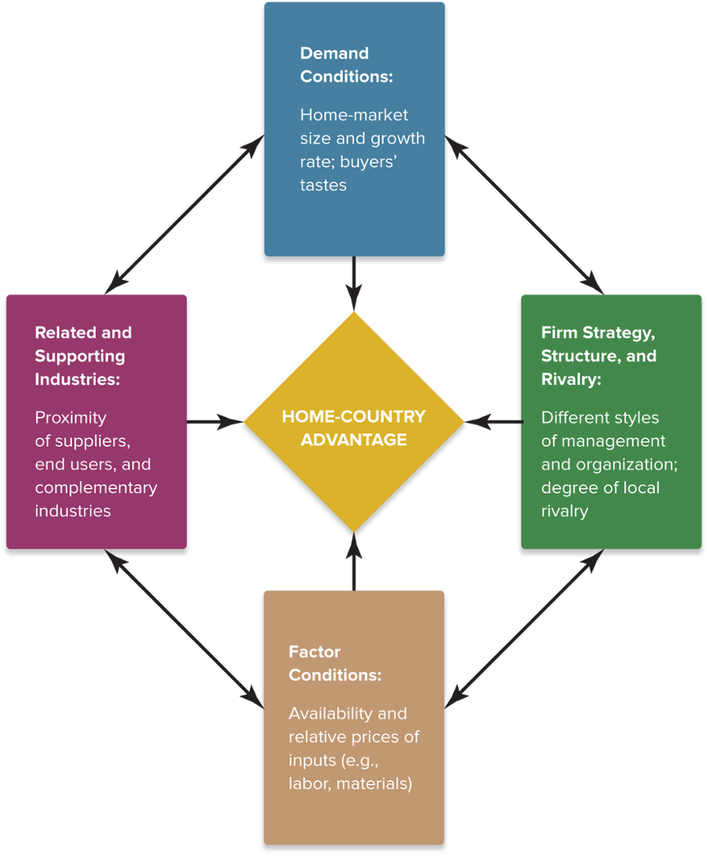
FIGURE 7.1 The Diamond of National Advantage
Jump to Appendix 2 long image description

Slide 6
THE DIAMOND FRAMEWORK
Answers important questions about competing on an international basis by:
Predicting where new foreign entrants are likely to come from and their strengths
Highlighting foreign market opportunities where rivals are weakest
Identifying the location-based advantages of conducting certain value chain activities of the firm in a particular country

Slide 7
REASONS FOR LOCATING VALUE CHAIN ACTIVITIES ADVANTAGEOUSLY
Lower wage rates
Higher worker productivity
Lower energy costs
Fewer environmental regulations
Lower tax rates
Lower inflation rates
Proximity to suppliers and technologically related industries
Proximity to customers
Lower distribution costs
Available or unique natural resources

Slide 8
THE IMPACT OF GOVERNMENT POLICIES AND ECONOMIC CONDITIONS IN HOST COUNTRIES
Positives
Tax incentives
Low tax rates
Low-cost loans
Site location and development
Worker training
Negatives
Environmental regulations
Subsidies and loans to domestic competitors
Import restrictions
Tariffs and quotas
Local-content requirements
Regulatory approvals
Profit repatriation limits
Minority ownership limits

Slide 9
Core Concepts (1 of 6)
Political risks stem from instability or weaknesses in national governments and hostility to foreign business.
Economic risks stem from the stability of a country’s monetary system, economic and regulatory policies, the lack of property rights protections.

Slide 10
THE RISKS OF ADVERSE EXCHANGE RATE SHIFTS
Effects of exchange rate shifts
Exporters experience a rising demand for their goods whenever their currency grows weaker relative to the importing country’s currency.
Exporters experience a falling demand for their goods whenever their currency grows stronger relative to the importing country’s currency.

Slide 11
STRATEGIC MANAGEMENT PRINCIPLE (1 of 6)
Fluctuating exchange rates pose significant economic risks to a firm’s competitiveness in foreign markets.
Exporters are disadvantaged when the currency of the country where goods are being manufactured grows stronger relative to the currency of the importing country.

Slide 12
STRATEGIC MANAGEMENT PRINCIPLE (2 of 6)
Domestic companies facing competitive pressure from lower-cost imports benefit when their government’s currency grows weaker in relation to the currencies of the countries where the lower-cost imports are being made.

Slide 13
Thinking Strategically
What effects has the adoption of the euro had on the ability of European Union (EU) countries and firms to respond to changes in intra-national economic conditions given that they now share a common currency?
What should a EU firm do to respond to a adverse currency exchange rate shift in a non-EU country?
How will exiting the EU affect the United Kingdom’s ability to compete in world markets?

Slide 14


CROSS-COUNTRY DIFFERENCES IN DEMOGRAPHIC, CULTURAL, AND MARKET CONDITIONS
Whether to customize offerings in each country market to match the tastes and the preferences of local buyers
Key Strategic Considerations
Whether to pursue a strategy of offering a mostly standardized product worldwide
Jump to Appendix 3 long image description

Slide 15
STRATEGIC OPTIONS FOR ENTERING AND COMPETING IN INTERNATIONAL MARKETS
Maintain a home country production base and export goods to foreign markets.
License foreign firms to produce and distribute the firm’s products abroad.
Employ a franchising strategy in foreign markets.
Establish a subsidiary in a foreign market via acquisition or internal development.
Rely on strategic alliances or joint ventures with foreign companies.

Slide 16
EXPORT STRATEGIES
Advantages
Low capital requirements
Economies of scale in utilizing existing production capacity
No distribution risk
No direct investment risk
Disadvantages
Maintaining relative cost advantage of home-based production
Transportation and shipping costs
Exchange rates risks
Tariffs and import duties
Loss of channel control

Slide 17
LICENSING AND FRANCHISING STRATEGIES
Advantages
Low resource requirements
Income from royalties and franchising fees
Rapid expansion into many markets
Disadvantages
Maintaining control of proprietary know-how
Loss of operational and quality control
Adapting to local market tastes and expectations

Slide 18
FOREIGN SUBSIDIARY STRATEGIES
Advantages
High level of control
Quick large-scale market entry
Avoids entry barriers
Access to acquired firm’s skills
Disadvantages
Costs of acquisition
Complexity of acquisition process
Integration of the firms’ structures, cultures, operations, and personnel

Slide 19
Core Concept (2 of 6)
A greenfield venture is a subsidiary business that is established by setting up the entire operation from the ground up.

Slide 20
USING A GREENFIELD STATEGY FOR DEVELOPING A FOREIGN SUBSIDIARY
A greenfield strategy is appealing when:
Creating an internal startup is cheaper than making an acquisition
Adding new production capacity will not adversely impact the supply-demand balance in the local market
A startup subsidiary has the ability to gain good distribution access
A startup subsidiary will have the size, cost structure, and resource strengths to compete head-to-head against local rivals

Slide 21
PURSUING A GREENFIELD STRATEGY
Advantages
High level of control over venture
“Learning by doing” in the local market
Direct transfer of the firm’s technology, skills, business practices, and culture
Disadvantages
Capital costs of initial development
Risks of loss due to political instability or lack of legal protection of ownership
Slowest form of entry due to extended time required to construct facility

Slide 22
BENEFITS OF ALLIANCE AND JOINT VENTURE STRATEGIES
Gaining partner’s knowledge of local market conditions
Achieving economies of scale through joint operations
Gaining technical expertise and local market knowledge
Sharing distribution facilities and dealer networks, and mutually strengthening each partner’s access to buyers
Directing competitive energies more toward mutual rivals and less toward one another
Establishing working relationships with key officials in the host-country government

Slide 23
Strategic Management Principle (3 of 6)
Collaborative strategies involving alliances or joint ventures with foreign partners are a popular way for companies to edge their way into the markets of foreign countries.

Slide 24
Strategic Management Principle (4 of 6)
Cross-border alliances enable a growth-minded firm to widen its geographic coverage and strengthen its competitiveness in foreign markets; at the same time, they offer flexibility and allow a firm to retain some degree of autonomy and operating control.

Slide 25
Walgreens Boots Alliance, Inc.: Entering Foreign Markets via Alliance Followed by Merger
Did industry consolidation provoke Walgreens to make its strategic international acquisition?
What strategic advantages does the alliance between Walgreens and Alliance Boots bring to both partners?
What internal problems could the merger create for Walgreens as it strives to integrate and adjust to the risks of entry into international markets?

Slide 26
THE RISKS OF STRATEGIC ALLIANCES WITH FOREIGN PARTNERS
Outdated knowledge and expertise of local partners
Cultural and language barriers
Costs of establishing the working arrangement
Conflicting objectives and strategies or deep differences of opinion about joint control
Differences in corporate values and ethical standards
Loss of legal protection of proprietary technology or competitive advantage
Overdependence on foreign partners for essential expertise and competitive capabilities

Slide 27




INTERNATIONAL STRATEGY: THE THREE MAIN APPROACHES
Competing Internationally
Multidomestic Strategy
Global Strategy
Transnational Strategy

Slide 28
Core Concepts (3 of 6)
An international strategy is a strategy for competing in two or more countries simultaneously.
A multidomestic strategy is one in which a firm varies its product offering and competitive approach from country to country in an effort to be responsive to differing buyer preferences and market conditions. It is a think-local, act-local type of international strategy, facilitated by decision making decentralized to the local level.

Slide 29
Core Concepts (4 of 6)
A global strategy is one in which a firm employs the same basic competitive approach in all countries where it operates, sells much the same products everywhere, strives to build global brands, and coordinates its actions worldwide with strong headquarters control. It represents a think-global, act-global approach.
A transnational strategy is a think-global, act-local approach that incorporates elements of both multidomestic and global strategies.

Slide 30
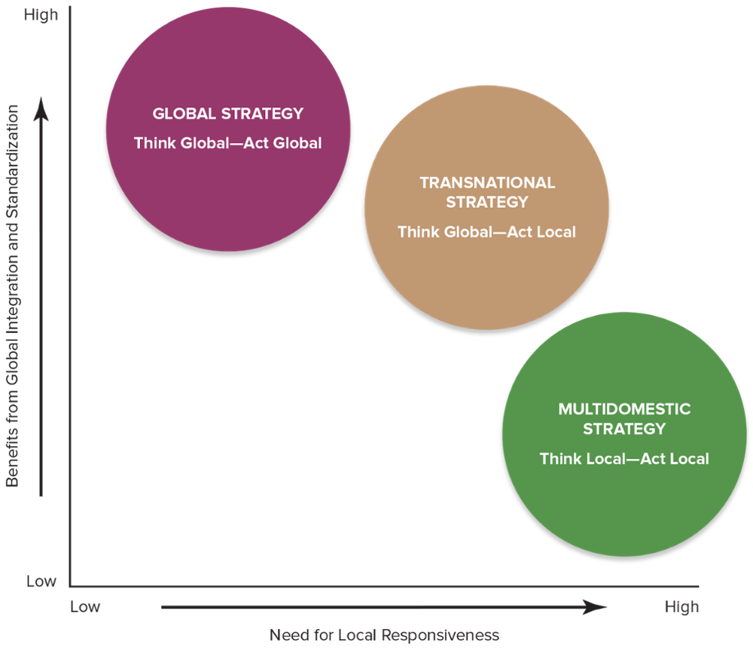
FIGURE 7.2 Three Approaches for Competing Internationally
Jump to Appendix 4 long image description

Slide 31
INTERNATIONAL OPERATIONS AND THE QUEST FOR COMPETITIVE ADVANTAGE
Build Competitive Advantage in International Markets
Use international location to lower cost or differentiate product
Share resources and capabilities
Gain cross-border coordination benefits
Jump to Appendix 5 long image description

Slide 32
TABLE 7.1 Advantages and Disadvantages of a Multidomestic Strategy
Multidomestic (think local, act local)
Advantages | Disadvantages
Can meet the specific needs of each market more precisely | Hinders resource and capability sharing or cross-market transfers
Can respond more swiftly to localized changes in demand | Has higher production and distribution costs
Can target reactions to the moves of local rivals | Is not conductive to a worldwide competitive advantage
Can respond more quickly to local opportunities and threats

Slide 33
TABLE 7.1 Advantages and Disadvantages of a Global Strategy
Global (think global, act global)
Advantages | Disadvantages
Has lower costs due to scale and scope economies | Cannot address local needs precisely
Can lead to greater efficiencies due to the ability to transfer best practices across markets | Is less responsive to changes in local market conditions
Increases innovation from knowledge sharing and capability transfer | Involves higher transportation costs and tariffs
Offers the benefit of a global brand and reputation | Has higher coordination and integration costs

Slide 34
TABLE 7.1 Advantages and Disadvantages of Transnational Strategy
Transnational (think global, act local)
Advantages | Disadvantages
Offers the benefits of both local responsiveness and global integration | Is more complex and harder to implement
Enables the transfer and sharing of resources and capabilities across borders | Entails conflicting goals, which may be difficult to reconcile and require trade-offs
Provides the benefits of flexible coordination | Involves more costly and time-consuming implementation

Slide 35
Four Seasons Hotels: Local Character, Global Service
Why has Four Seasons Hotels been so successful in expanding its hospitality operations into a broad diversity of countries?
How should local hotel competitors respond to Four Seasons Hotels’ continued expansion into their markets?
Why has the global economic slowdown not dampened demand for the Four Seasons luxury hotel offerings?

Slide 36
USING LOCATION TO BUILD COMPETITIVE ADVANTAGE
To customize offerings in each country market to match tastes and preferences of local buyers
Key Location Issues
To pursue a strategy of offering a mostly standardized product worldwide
Jump to Appendix 6 long image description

Slide 37
Strategic Management Principle (5 of 6)
Companies that compete internationally can pursue competitive advantage in world markets by locating their value chain activities in whatever nations prove most advantageous.

Slide 38
WHEN TO CONCENTRATE ACTIVITIES IN A FEW LOCATIONS
The costs of manufacturing or other activities are significantly lower in some geographic locations than in others.
There are significant scale economies in production or distribution.
There are sizable learning and experience benefits associated with performing an activity in a single location.
Certain locations have superior resources, allow better coordination of related activities, or offer other valuable advantages.

Slide 39
WHEN TO DISPERSE ACTIVITIES ACROSS MANY LOCATIONS
Buyer-related activities can be conducted at a distance.
There are high transportation costs.
There are diseconomies of large size.
Trade barriers make a central location too expensive.
Dispersing activities reduces exchange rate risks.
Dispersion helps prevent supply interruptions.
Dispersion helps avoid adverse political developments.
Dispersion allows for location-based technology and production cost competitive advantages.

Slide 40
SHARING AND TRANSFERRING RESOURCES AND CAPABILITIES TO BUILD COMPETITIVE ADVANTAGE
Building a resource-based competitive advantage requires:
Using powerful brand names to extend a differentiation-based competitive advantage beyond the home market
Coordinating activities for sharing and transferring resources and production capabilities across different countries’ domains to develop market dominating depth in key competencies

Slide 41
Core Concepts (5 of 6)
Profit sanctuaries are country markets that provide a firm with substantial profits because of a strong or protected market position.
Cross-market subsidization—supporting competitive offensives in one market with resources and profits diverted from operations in another market—can be a powerful competitive weapon.

Slide 42
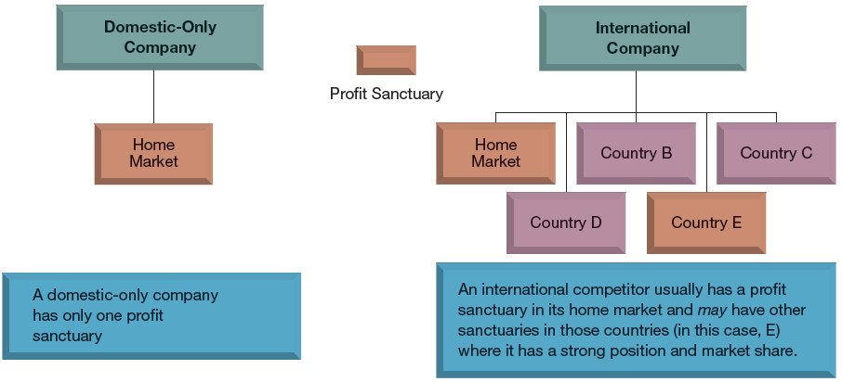
PROFIT SANCTUARY POTENTIAL OF DOMESTIC-ONLY AND INTERNATIONAL COMPETITORS
Jump to Appendix 7 long image description

Slide 43
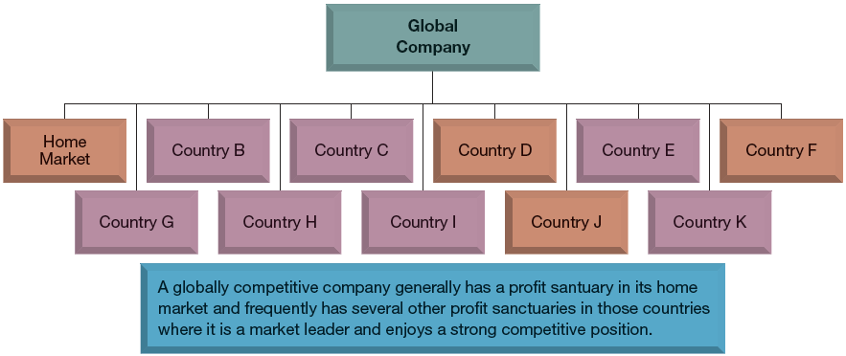
PROFIT SANCTUARY POTENTIAL OF GLOBAL COMPETITORS
Jump to Appendix 8 long image description

Slide 44
DUMPING AS A STRATEGY
Dumping
Selling goods in foreign markets at prices that are either below normal home market prices or below the full costs per unit
Dumping is NOT a fair-trade practice.
Governments can be expected to retaliate against such practices by foreign competitors.
The World Trade Organization (WTO) actively polices dumping to discourage such practices.

Slide 45
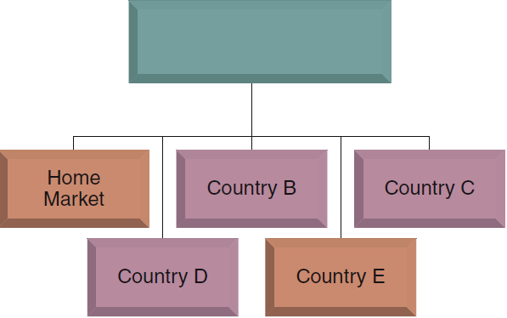
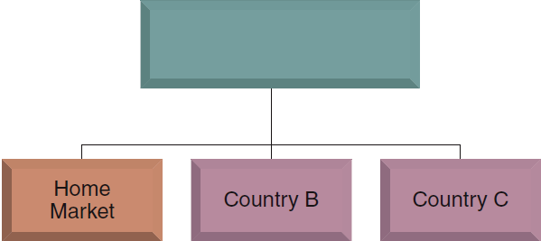

USING PROFIT SANCTUARIES TO DEFEND AGAINST INTERNATIONAL RIVALS
International Firm A
International Firm B
Profit Sanctuary
Firm A moves against Firm B in Country B
Firm B counters with a response in Country C
Jump to Appendix 9 long image description

Slide 46
Core Concept (6 of 6)
When the same companies compete against one another in multiple geographic markets, the threat of cross-border counterattacks may be enough to deter aggressive competitive moves and encourage mutual restraint among international rivals.

Slide 47
STRATEGY OPTIONS FOR COMPETING IN THE MARKETS OF DEVELOPING COUNTRIES
Prepare to compete on the basis of low price.
Prepare to modify the firm’s business model or strategy to accommodate local circumstances.
Try to change the local market to better match the way the firm does business elsewhere.
Stay away from developing markets where it is impractical or uneconomical to modify the company’s business model to accommodate local circumstances.

Slide 48
DEFENDING AGAINST GLOBAL GIANTS: STRATEGIES FOR LOCAL COMPANIES IN DEVELOPING COUNTRIES
Develop a business model that exploits shortcomings in local distribution networks or infrastructure.
Utilize knowledge of local customer needs and preferences to create customized products or services.
Take advantage of aspects of the local workforce with which large multinational firms may be unfamiliar.
Use acquisition and rapid-growth strategies to defend against expansion-minded internationals.
Transfer company expertise to cross-border markets and initiate actions to contend on an international level.

Slide 49
Strategic Management Principle (6 of 6)
Profitability in developing markets rarely comes quickly or easily—new entrants have to adapt their business models to local conditions and be patient in earning a profit.

Slide 50
How Ctrip Successfully Defended Against International Rivals to Become China’s Largest Online Travel Agency
What were the key elements of Ctrip’s business model that allowed it to successfully fend off the entry of major international rivals in its market?
What changes in Ctrip’s external competitive environment will eventually threaten its continued success?
How could the Diamond of National Competitive Advantage be useful to Ctrip in predicting the future of the travel industry in China?

Slide 51
Appendix 1 Why Companies Decide to Enter Foreign Markets
To gain access to new customers
To achieve lower costs through economies of scale, experience, and increased purchasing power
To further exploit core competencies
To gain access to resources and capabilities located in foreign markets
To spread business risk across a wider market base
Return to slide

Slide 52
Appendix 2 Figure 7.1 The Diamond of National Advantage
The four factors that influence each other and a company's home-country advantage are:
Demand conditions: home-market size and growth rate; buyers' tastes
First strategy, structure, and rivalry: different styles of management and organization; degree of local rivalry
Factor conditions: availability and relative prices of inputs (e.g. labor, materials)
Related and supporting industries: proximity of suppliers, end users, and complementary industries
Return to slide

Slide 53
Appendix 3 Cross-Country Differences in Demographic, Cultural, and Market Conditions
Two key strategic considerations
To customize offerings in each country market to match the tastes and preferences of local buyers
To pursue a strategy of offering a mostly standardized product worldwide
Return to slide

Slide 54
Appendix 4 Figure 7.2 Three Approaches for Competing Internationally
A grid is shown. The vertical axis, Benefits from Global Integration and Standardization, is labeled “high” at the top and “low” at the bottom. The horizontal axis, Need for Local Responsiveness, is labeled “low” on the left side and “high” on the right. Three strategies are charted on the graph:
Global strategy: think global, act global. High benefits; low need for local responsiveness.
Transnational strategy: think global – act local. Mid-high benefits; mid-high need for local responsiveness.
Multidomestic strategy: think local – act local. Low benefits; high need for local responsiveness.
Return to slide

Slide 55
Appendix 5 International Operations and the Quest for Competitive Advantage
Three ways to build competitive advantage in international markets are:
Use international location to lower cost or differentiate product
Share resources and capabilities
Gain cross-border coordination benefits
Return to slide

Slide 56
Appendix 6 Using Location to Build Competitive Advantage
Two key location issues are:
To customize offerings in each country market to match tastes and preferences of local buyers
To pursue a strategy of offering a mostly standardized product worldwide
Return to slide

Slide 57
Appendix 7 Profit Sanctuary Potential of Domestic-Only and International Competitors
A domestic-only company only reaches out to the home market, and thus only has one profit sanctuary. An international company, on the other hand, reaches out to the home market, as well as several other countries. This means the company usually has a profit sanctuary in its home market, but may also have other sanctuaries in other countries where it has a strong position and market share.
Return to slide

Slide 58
Appendix 8 Profit Sanctuary Potential of Global Competitors
A globally competitive company generally has a profit sanctuary in its home market and frequently has several other profit sanctuaries in those countries where it is a market leader and enjoys a strong competitive position.
Return to slide

Slide 59
Appendix 9 Using Profit Sanctuaries to Defend Against International Rivals
Firm A moves against Firm B in Country B, where Firm B has a presence. Firm B then counters by a response in Country C, where Firm A has a presence.
Return to slide

